Slide 1
Software Project Management Introduction
Dr. D Evangelin geetha
Associate professor
Department of master of computer applications
Ramaiak institute of technology
Bangalore - 560054

Slide 2
About the course
Course Code: MCAE31
Course Name: Software Project Management
Credit: 3:0:0
Contact Hours: 42 Lecture Hours
Text Book
  Bob Hughes, Mike Cotterell and Rajib Mall, Software Project Management,6th Edition, Tata McGraw Hill, New Delhi, 2018.

Slide 3
Assessment
2 Internal Assessment
  Average of 2 – 30 Marks
Other Components
  Quiz – 10 Marks
  Assignment – 10 Marks

Slide 4
About the course
Course Outcomes
  Discuss the software project evaluation and project planning
  Apply software process models and software effort estimation techniques
  Plan the software activities and manage the risks
  Handle the framework for software project management and manage the change control
  Manage the staffing in software projects

Slide 5
Main Scopes of SPM
1. Project Evaluation
2. Project Planning
3. Software effort estimation
4. Activity planning
5. Risk Management
6. Resource allocation
7. Managing contracts
8. Managing people
9. Monitoring and control
10. Software quality

Slide 6
Introduction to SPM
Objectives:
  Define the scopes of SPM
  Understand what project managers worry about
  Define the phases of a software project
  Explain the factors of management
  Be conscious of that a project needs elaborative planning, monitoring and control
  Identify stakeholders and their objectives
  Define the criteria of success

Slide 7
what is software project management?
Software project management refers to the branch of project management dedicated to the planning, scheduling, resource allocation, execution, tracking and delivery of software projects.
Ensuring that objectives of stakeholders are met is the aim of project management

Slide 8
Why is SPM important?
Unfortunately, projects are not always successful.
  Standish Group in the U.S. analyzed 13,522 projects and concluded that only a third of them were successful; 82 percent were late and 43 percent exceeded their budget.
  The reason for these project shortcomings is often the management of projects.

Slide 9
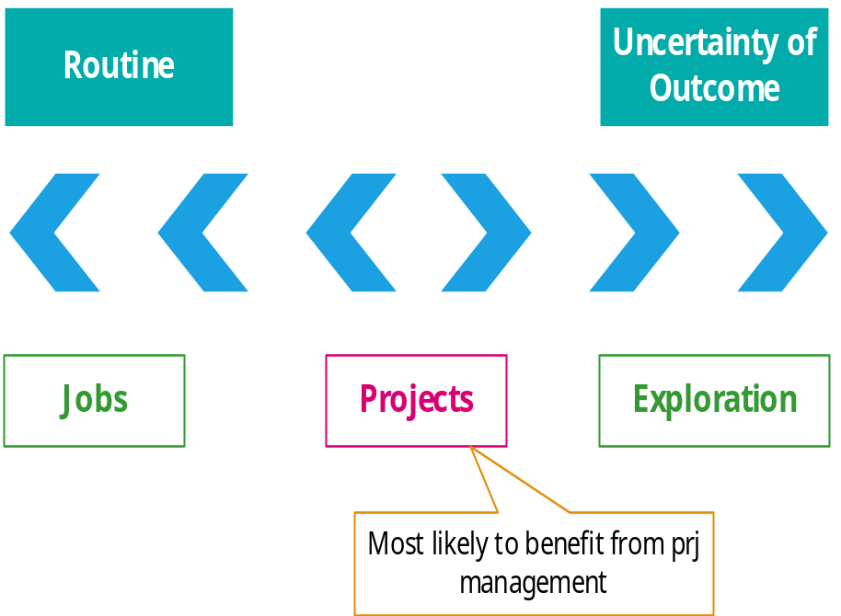
What is a project?
In dictionary definition, it emphases on
-----Being planned activity
  Routine: one knows exactly what to do
  Exploratory: full of uncertainties and risks
    e.g. finding a cure for cancer:
    the outcome is very uncertain

Slide 10
What is a project?
The characteristics distinguish projects:
  non-routine tasks are involved;
  planning is required;
  specific objectives are to be met or a specified product is to be created;
  the project has a predetermined time span;
  work is carried out for someone other than yourself;
  work involves several specialism;
  people are formed into a temporary work group to carry out the task ;
  work is carried out in several phases;
  the resources that are available for use on the project are constrained;
  the project is large or complex.
The more any of these factors apply to a task, the more difficult that task will be.

Slide 11
Exercise 1.1
Consider the following:
  Producing an edition of a newspaper
  Putting a robot vehicle on Mars to search for signs of life
  Getting married
  Amending a financial computer system to deal with a common European currency
  A second year programming assignment for a computing student
  Installing a new version of a word processing package in an organization.

Slide 12
Exercise 1.1 - Solution
Consider the following:
  Putting a robot vehicle on Mars to search for signs of life
  Amending a financial computer system to deal with a common European currency
  Installing a new version of a word processing package in an organization.
  Getting married
  Producing an edition of a newspaper
  A second year programming assignment for a computing student

Slide 13
Project Constraints
Scope:
  What work will be done as part of the project
  What unique product, service, or result does the customer or sponsor expect from the project
Time
  How long should it take to complete the project
  Who can approve changes to the schedule
Cost
  What is the project’s budget
  Who can authorize changes to the budget

Slide 14
Software prj vs. other types of prj
Invisibility: With software, progress is not immediately visible
Complexity: Per dollar, software products contain more complexity than other engineered artefacts
Conformity: Software developers have to conform to the requirements of human clients
Flexibility: Software systems are particularly subject to change

Slide 15
Contract Management and Technical Project Management
In-house projects – users and developers belong to same organization
ICT Project – Information and Communication Technology Project

Slide 16
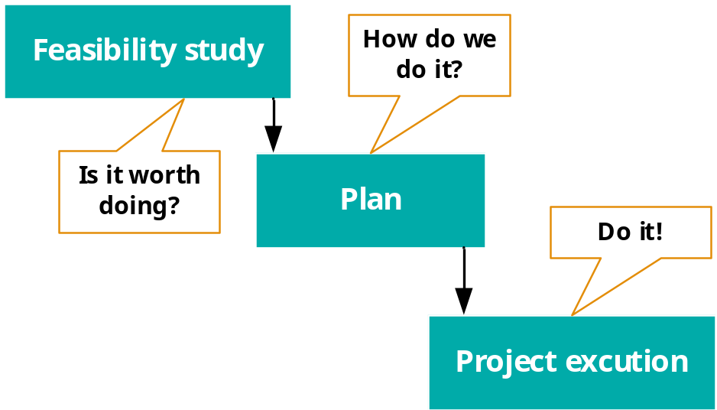
Activities covered by SPM
A software project is not only concerned with the actual writing of software. In fact, where a software application is bought in “off the shelf”, there may be no software writing as such, but this is still fundamentally a software project because so many of the other activities associated with software will still be present.
Three successive processes

Slide 17
Activities covered by SPM
1. The feasibility study: assesses whether a project is worth starting – that it has a valid business case.
2. Planning: If the feasibility study indicates that the prospective project appears viable, then project planning can start.
3. Project execution: The execution of a project often contains design and implementation sub-phases.
  Design is making decisions about the form of the products to be created.
  Planning details the activities to be carried out to create these products.
    E.g., Activities recommended in the international standard ISO 12207

Slide 18
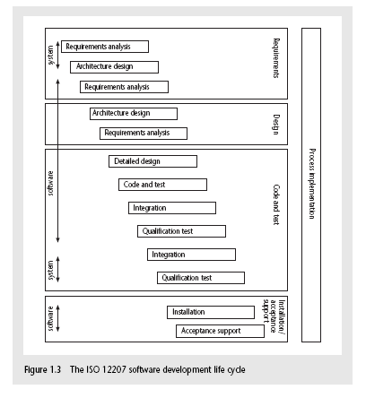
The software development life-cycle (ISO 12207)

Slide 19
ISO 12207 life-cycle
Requirements analysis
  Requirements elicitation: what does the client need?
  Analysis: converting ‘customer-facing’ requirements into equivalents that developers can understand
  Requirements will cover
    Functions
    Quality (e.g. Ambulance)
    System requirement (Operators)
    Resource constraints i.e. costs

Slide 20
ISO 12207 life-cycle
Architecture design
  Based on system requirements
  Defines components of system: hardware, software, organizational
  Software requirements will come out of this
Detailed Design
  Number of software units in each software component
Code and test
  Of individual components
Integration
  Putting the components together

Slide 21
ISO 12207 life-cycle
Qualification testing
  Testing the system (not just the software)
Installation
  The process of making the system operational
  Includes setting up standing data, setting system parameters, installing on operational hardware platforms, user training etc
Acceptance support
  Including maintenance and enhancement

Slide 22
Exercise 1.2
Brightmouth College is a higher education institution which used to be managed by a local government authority but has now become autonomous. Its payroll is still administered by the local authority and pay slips and other outputs are produced in the local authority’s computer centre. The authority now charges the college for this service. The college management are of the opinion that it would be cheaper to obtain an ‘off-the-shelf’ payroll package and do the payroll processing themselves.
What would be the main stages of the project to convert to independent payroll processing by the college? Bearing in mind that an off-the-shelf package is to be used, how would this project differ from one where the software was to be written from scratch?

Slide 23
Exercise 1.2 - Solution
Project Evaluation
Planning
Requirements Elicitation and Analysis
Specification
Design/Coding
Verification and Validation
Implementation
Maintenance/Support

Slide 24
Exercise 1.3
Assume that a software organization development has been asked to carry out a feasibility study to develop the payroll package for Brightmouth College. The development organization plans to develop the software by customizing one of its existing products. What are the main steps through which the project manager of the organization would carry out the feasibility study?

Slide 25
Exercise 1.3 - Solution
Feasibilty study
  Discuss with stakeholders and understand the important features

Slide 26
Plans Methods and Methodologies
Method – plan for an activity must be based on some idea of a method of work.
  Analyse requirements
  Devise and write test cases
  Create test scripts and expected results for each test case
  Compare the actual and expected results
Method – type of activity
Plan – takes the method and converts it to real activities.

Slide 27
Plans Methods and Methodologies
For each activity, identify
  Its start and end dates
  Who will carry it out
  What tools and materials – including information - will be needed
Methodologies
  Groups of methods or techniques are grouped into methodologies (e. g. object-oriented design)

Slide 28
Some ways of categorizing software projects
Distinguishing different types of project is important as different types of task need different project approaches e.g.
Changes to the characteristics of software projects
  Reusability
  Customization
  Customer participation
Compulsory vs. voluntary users
  Supermarket transaction system vs. computer game
Information systems vs. embedded systems
  Office system vs. machine control system
Software products versus services
Objectives vs. products
  to meet certain objectives vs. to produce a product (course management system vs. anti-virus system)

Slide 29
Project charter
High-level document, authorizes the starting of a project
Outlines
  the project objectives
  deliverables and
  the resources required
  Additionally
    The aspects that are out of scope
    Identifies main stakeholders – roles and responsibilities

Slide 30
Project charter
Project sponsor
  Champions the project
  Monitors the progress of the project
  Provides regular feedback to project manager
  Helps in removing obstacles faced by the project manager
Project manager – responsible to prepare the project charte

Slide 31
Project charter
Project charter - Not expected to change throughout the project life cycle
Contents
  Overall objectives of the project
  Broad items within the scope and out of scope of the project
  Time schedule – start and completion date of the project
  Important stakeholders and their responsibilities
  Overview of the resources, overall budget
  Major risks and broad strategies to overcome that risks

Slide 32
Stakeholders
These are people who have a stake or interest in the project
In general, they could be users/clients or developers/implementers
They could be:
  Within the project team
  Outside the project team, but within the same organization
  Outside both the project team and the organization
Project leader
Communication plan

Slide 33
Setting objectives
Answering the question ‘What do we have to do to have a success?’
Need for a project authority
  Sets the project scope
  Allocates/approves costs
Could be one person - or a group
  Project Board
  Project Management Board
  Steering committee

Slide 34
Objectives
Informally, the objective of a project can be defined by completing the statement:
The project will be regarded as a success if………………………………..
Rather like post-conditions for the project
Focus on what will be put in place, rather than how activities will be carried out

Slide 35
Objectives should be SMART
S – specific, that is, concrete and well-defined
M – measurable, that is, satisfaction of the objective can be objectively judged
A – achievable, that is, it is within the power of the individual or group concerned to meet the target
R – relevant, the objective must relevant to the true purpose of the project
T – time constrained: there is defined point in time by which the objective should be achieved

Slide 36
Goals/sub-objectives
These are steps along the way to achieving the objective. Informally, these can be defined by completing the sentence…
Objective X will be achieved
IF the following goals are all achieved
A……………
B……………
C…………… etc

Slide 37
Goals/sub-objectives continued
Often a goal can be allocated to an individual.
Individual may have the capability of achieving goal, but not the objective on their own e.g.
  Objective – user satisfaction with software product
  Analyst goal – accurate requirements
  Developer goal – software that is reliable

Slide 38
Measures of effectiveness
How do we know that the goal or objective has been achieved?
By a practical test, that can be objectively assessed.
  e.g. for user satisfaction with software product:
Reliability
Performance
Predictive measures

Slide 39
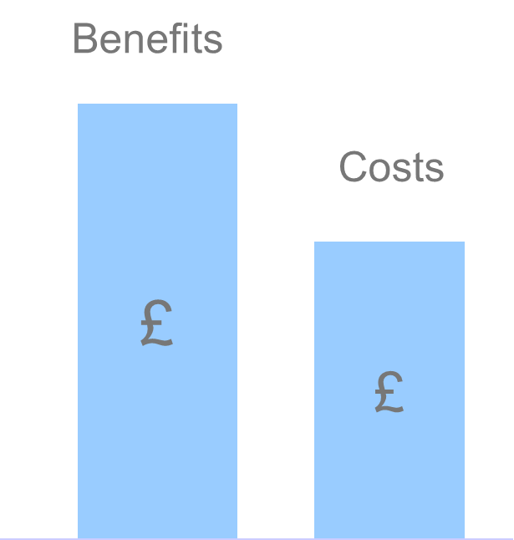
The business case
During project feasibility study
Benefits = Effort + Expense ?
Benefits of delivered project must outweigh costs
E.g. web based application for sales
Costs include:
  Development
  Operation
Benefits
  Quantifiable
  Non-quantifiable

Slide 40
The business case
Project plan must ensure that the business case is kept intact
  Development costs are not allowed to rise to a level which threatens to exceed the value of benefits
  Features of the system are not reduced to a level where the expected benefits cannot be realized
  Delivery date is not delayed so that there is an unacceptable loss of benefits

Slide 41
Project success and failure
The project plan should be designed to ensure project success
Project success can usually be summarized and delivering:
  The agreed functionality
  To the required level of quality
  On time
  Within budget
Project success vs. business success

Slide 42
Project success and failure
Project Objectives
  The agreed functionality
  To the required level of quality
  On time
  Within budget
Business Objective
  Benefits = Effort + Expense ?
Project objectives vs. Business Objectives
  Project could meet targets but application, once delivered could fail to meet the business case
  E.g. Computer Game, commercial website for Online Sales
Success = value of benefits > cost
Value of benefits - Dependent on external factors, no. of customers
Increasing development cost – reduces the profit
Delay – reduces the amount of time
Success -> Failure or Failure -> Success
  Solution ?

Slide 43
Project success and failure
Solution
  Having a broader view of projects that includes business issues
  E.g e-commerce website
    Market surveys
    Competitor analysis
    Focus groups
    Prototyping
    Evaluation by potential users
Consequence on subsequent projects
Customer Relationships
  Expensive to acquire new clients than it is to retain existing ones

Slide 44
What is management?
This involves the following activities:
Planning – deciding what is to be done
Organizing – making arrangements
Staffing – selecting the right people for the job
Directing – giving instructions
Monitoring – checking on progress
Controlling – taking action to remedy hold-ups
Innovating – coming up with solutions when problems emerge
Representing – liaising with clients, users, developers and other stakeholders
Notes:
This list is based on one that can be found in Introduction to Software Project Management and Quality Assurance by Darrel Ince, Helen Sharp and Mark Woodman, McGraw-Hill, 1993.

Slide 45
What is management?
Principal Project Management Processes
Initiating Process
Planning Process
Executing Process
Controlling Process
Project Closing
Project Initiation
Project Execution
Project Closing
Notes:
Exercise 1.6 (a day in the life of a project manager) is of relevance here.

Slide 47
What is management?
Project Planning
  Estimation
    Cost
    Duration
    Effort
  Scheduling and Staffing
    Scheduling
    Staffing
    Risk Management
    Miscellaneous plans

Slide 48
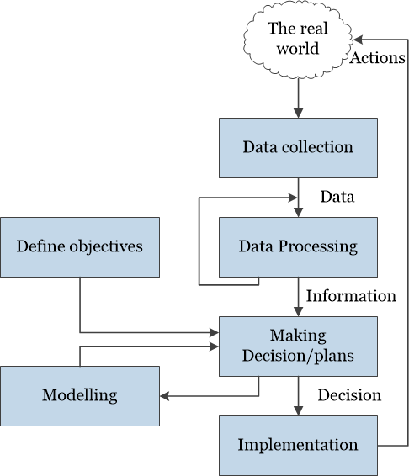
Management control
The Project Control Cycle

Slide 49
Exercise 1.11
An ICT project is to replace locally held paper-based records with a centrally organized database. Staff in a large number of offices that are geographically dispersed need training and will then have to use the new ICT system to set up the backlog of manual records on the new database. The system cannot be properly operational until the last record has been transferred. The new system will only be successful if new transactions can be processed within certain time cycles.
Identify the data that you would collect to ensure that during execution of the project things were going to plan.

Slide 50
Management control
Involves the local managers in data collection
Data collection
Data – the raw details
e.g. ‘6,000 documents processed at location X’
Data Processing
Information – the data is processed to produce something that is meaningful and useful
e.g. ‘productivity is 100 documents a day’
Comparison with objectives/goals
e.g. we will not meet target of processing all documents by 31st March

Slide 51
Management control
Making decisions/plans – against target not achieved according to estimation
Modelling – working out the probable outcomes of various decisions
  e.g. if we employ two more staff at location X how quickly can we get the documents processed?
  Moving staff from one location to another
Implementation – carrying out the remedial actions that have been decided upon

Slide 52
Management control
Project plan is dynamic
Need constant adjustment
A good plan provides a foundation for a good project, but nothing without intelligent execution

Slide 53
Software development and project management life cycles
Software development life cycle
Developers carry out
Software development process
Managers carry out
Project management processes
Project management life cycle
Project life cycle

Slide 54
Software development and project management life cycles
Project management life cycle
Initiating Phase
Planning Phase
Executing Phase
Closing Phase
Requirements analysis
Design
Develop
Test
Delivery
Software development life cycle

Slide 55
Project Management life cycle
Project Initiation
Project planning
Project execution
Project closure

Slide 56
Project Management life cycle
Project Initiation
  Project Concept development
  W5HH Principle (Boehm)
    Why
    What
    When
    Who
    Where
    How will the job be done technically and managerially
    How much of each resource is needed?

Slide 57
Project Management life cycle
Project Initiation
  Project bidding
    Request for Quotation (RFQ) – RFT: Request for Tender
    Request For Proposal (RFP)
    Request for Information (RFI)

Slide 58
Project Management life cycle
Project planning
  Project plan
  Resource plan
  Financial plan
  Quality plan
  Risk plan

Slide 59
Project Management life cycle
Project execution
Project closure

Slide 60
Key points
Projects are non-routine - thus uncertain
The particular problems of projects e.g. lack of visibility
Clear objectives are essential which can be objectively assessed
Stuff happens. Not usually possible to keep precisely plan – need for control
Communicate, communicate, communicate!

